Slide 1

My Journey
By Gabriel Antonio Zepeda

Slide 2
Table of Contents
My, I am
Goals – Short & Long Term
Why Cybersecurity?
Project - Security Operations Center (SOC) Virtual Lab
SOC Analyst

Slide 3

My, I am

Slide 4

My, I am
Brother
Dreamer
Son
Learner
Friend
Teacher
Listener
Fighter
Problem-Solver
Lover
Goof

Slide 5

My, I am
Who I am
“I am not one role; I am the sum of all the roles I’ve played — student, teacher, lover, dreamer.” — Unknown

Slide 6

My, I am
Background
A little about myself
Hands-on kind of guy
Prefer to keep it simple
Love to learn
Building community

Slide 7

My, I am
What drives me?
I believe we should try our best to realize our potential and the potential of those around us. To build each other up make the world around us a brighter place.

Slide 8

Goals
“Setting goals is the first step in turning the invisible into the visible.” — Tony Robbins

Slide 9

Goals
1
2
I’m thankful to DAE for giving me a chance to strengthen my competency in not only tech but also in and giving me a chance to grow confident into a whole new career path
While in DAE I hope to grow as a person in my ability to stand on my own two feet as a professional cyber security analyst

Slide 10
Goals
Short-Term
Long-Term
Learn as many tech stacks as possible within my specialization.
Build excellent documentation habits as an SOC Analyst.
Creating a solid learning portfolio.
Improve my communication in presenting on a professional level.
Remain caught up on industry news.
Obtain my certifications.
Master the appropriate tech stacks as a cyber security professional.
Soft skill mastery and undertaking leadership roles.
Move up the SOC Tier tracks from Tier 1 to 2 to 3
Adopt life long learning.

Slide 11

Why Cybersecurity?

Slide 12
Why Cybersecurity
Rationale
Digital Detective
Flexibility & Growth
Engaging
As a cyber threat hunter the idea of protecting people & organizations appeals to me. A clear sense of mission.
High demand / job security with a large range of roles and opportunities. 1000+ jobs daily.
The real incidents which happen keep the job dynamic, no two incidents will be truly the same.

Slide 13
Project
SOC Virtual Lab
A simulated security operations environment

Slide 14
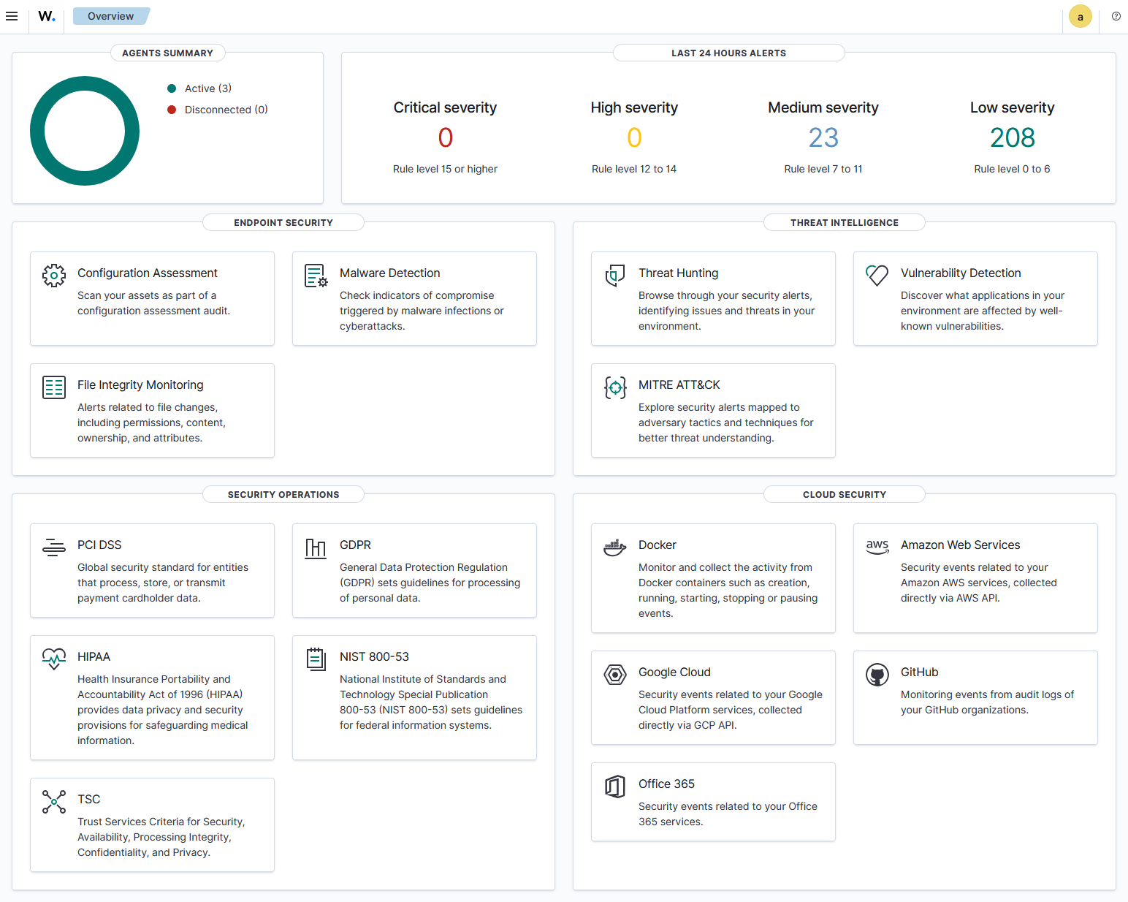
Project
What is a Virtual Lab?
The goal is to create a virtual environment which can be used to test multiple simulated attacks. Mainly for learning purposes and mastery of malicious attacks, detectionm, and remediation techniques.

Slide 15
Project
Schedule
May
June
July
August
September
October
PHASE 1
June 5th - August 20th
Task 1
June 5th – June 9th
Task 2
July 7th – July 10th
PHASE 2
Aug 25th – Oct 9th
Task 1
Aug 25th - Aug 28th
Task 2
Aug 25th – Oct 2nd

Slide 16
Project
Key Concepts
Virtual Machines & Operating Systems
Security Information Event Managers
Malicious Attack Vectors & Techniques
- Rulesets - Correlation - Playbooks
SOC Report Documentation
Digital Forensics & Attacker Timelines (TTP)

Slide 17
Project
Research
Testing
Analysis
Documentation
Deciding ADR and simulated attacks
Implementing my lab, simulated attacks, and SIEM software
Compile logs, establish rulesets, and playbooks
Create a professional report on each attack vector based on industry standard legal and ethical compliance

Slide 18

SOC Analyst

Slide 19


SOC Analyst
A SOC Analyst (Security Operations Center Analyst) is a cybersecurity professional responsible for monitoring, detecting, investigating, and responding to security incidents within an organization. They work inside a Security Operations Center (SOC), which is the command hub for defending an organization’s digital infrastructure.

Slide 20

SOC Analyst
—Someone famous
What excites me about being an SOC Analyst is how flexible it is and how many doorways it can open to more advanced fields within the Cybersecurity industry.

Slide 21
SOC Analyst
Global Need
Remote Work
In this technological age the demand is expanding
Hiring from any country for expert professionals.

Slide 22

SOC Analyst
33%
$60-$70k
450,000
Growth over 10 years with a current talent shortage
Current entry level salary
Unfilled roles in the U.S. alone

Slide 23

Thanks!
Thank You!

